Slide 1
FIFA World Cup Analysis

Slide 2


Problem Statement:
With FIFA is in the blood of many people of the world. You are tasked to tell the story of unsung analysts who put great efforts to provide accurate data to answer every question of fans. The FIFA World Cup is a global football competition contested by the various football-playing nations of the world. It is contested every four years and is the most prestigious and important trophy in the sport of football. The World Cups dataset shows all information about all the World Cups in history, while the World Cup Matches dataset shows all the results from the matches contested as part of the cups. Find key metrics and factors that influence the World Cup win. Do your own research and come up with your findings.

Slide 3
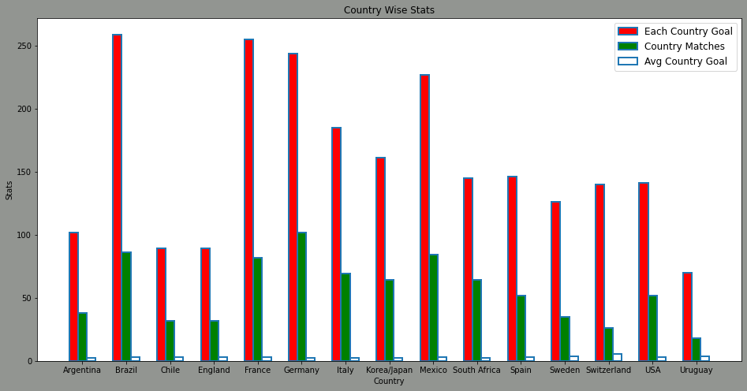
Dashboard
FIFA World Cup Analysis

Slide 4
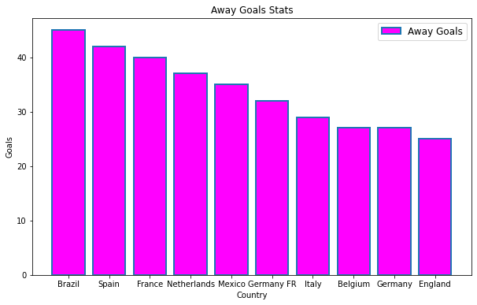
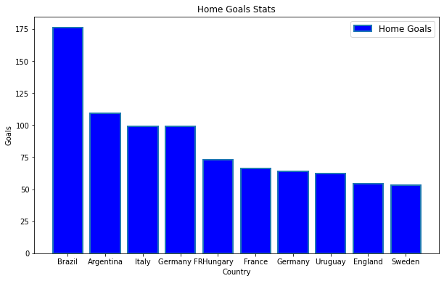

Slide 5
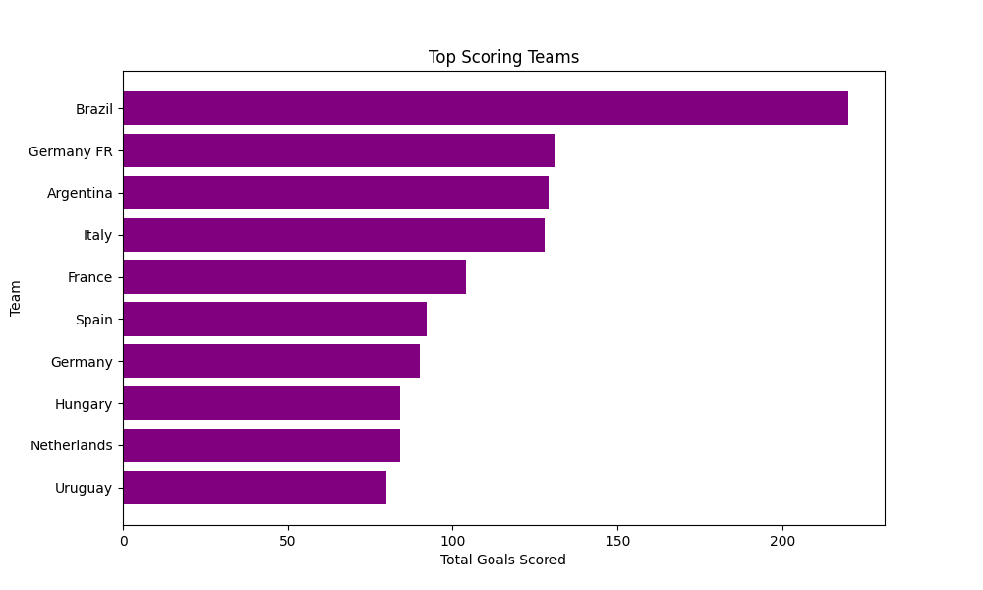
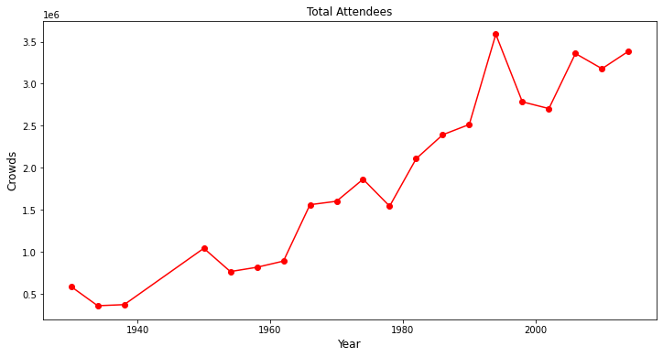

Slide 6
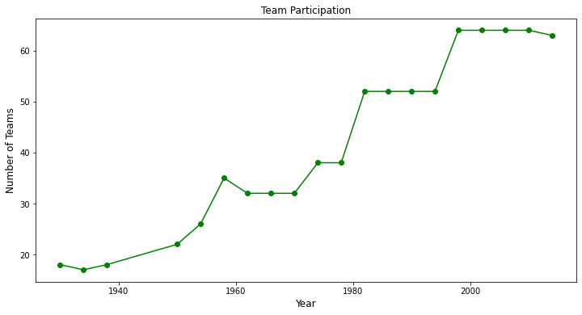
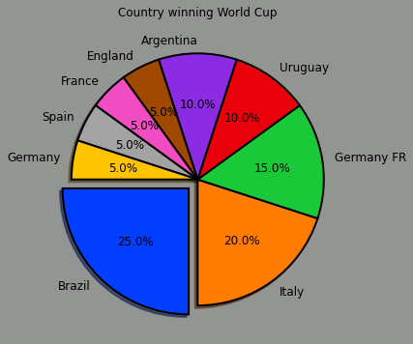

Slide 7
BASED ON ANALYSIS FIFA Wc WE CAN DRAW THE FOLLOWING
# By seeing the analysis we can say that Brazil , Germany & Italy are the most successful teams in tournament.
# Brazil has won most no. of titles.
# Germany & Italy has almost equal no. of titles.
# We can conclude that Brazil is most 'Successful Team' in the tournament.
#Attendance can be boosting factor in winning ,as audience cheers & boost the confidence of players.
#Match Outcomes by 'Home Team' as winning is more. [57%]
#We can conclude that Home Team has more advantage od winning tournament.

Slide 8
Thank you

